Slide 1
DSP Lab. Week 7 Fourier Transform
Kyuheon Kim
Media Lab. Rm567
kyuheonkim@khu.ac.kr
Last update : September 2, 2019

Slide 2
MOTIVATION
Synthesize Complicated Signals
Musical Notes
Piano uses 3 strings for many notes
Chords: play several notes simultaneously
Human Speech
Vowels have dominant frequencies
Application: computer generated speech
Can all signals be generated this way?
Sum of sinusoids?

Slide 3
Euler’s Formula Reversed
Solve for cosine (or sine)
ω
−
ω
cos(
ω
=
1
j
t
+
j
t
t
)
(
e
e
)
2

Slide 4
Inverse Euler’s Formula
Solve for cosine (or sine)

Slide 5
Spectrum Interpretation
Cosine = sum of 2 complex exponentials:
One has a positive frequency
The other has negative freq.
Amplitude of each is half as big

Slide 6
Spectrum Interpretation
Sine = sum of 2 complex exponentials:
Positive freq. has phase = -0.5π
Negative freq. has phase = +0.5π

Slide 7
Fourier Series
ANALYSIS
Get representation from the signal
Works for PERIODIC Signals
Fourier Series
Answer is: an INTEGRAL over one period
T
0
=
∫
−
ω
a
x
j
k
t
(
t
)
1
e
0
dt
k
T
0
0

Slide 8
What if x(t) is not periodic?
Sum of Sinusoids?
Non-harmonically related sinusoids
Would not be periodic, but would probably be non-zero for all t.
Fourier transform
gives a “sum” (actually an integral) that involves ALL frequencies
can represent signals that are identically zero for negative t. !!!!!!!!!

Slide 9
Fourier Transform
Fourier Synthesis
(Inverse Transform)
Fourier Analysis
(Forward Transform)
Time
-
Domain
⇔
Frequency
-
Domain
x
⇔
ω
(
t
)
X
(
j
)

Slide 10
Fourier Transform Property
Differentiation Property

Slide 11
Fourier Transform Property
Linearity Property
Delay Property
Frequency Shifting
Scaling

Slide 12
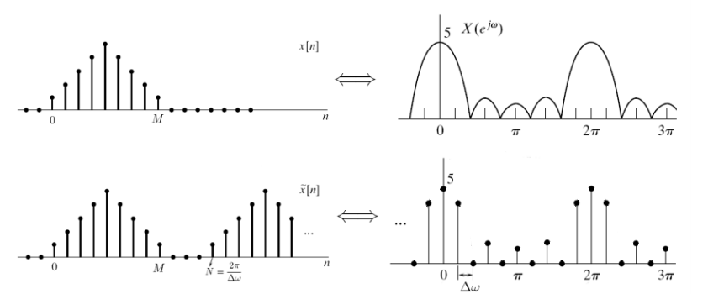
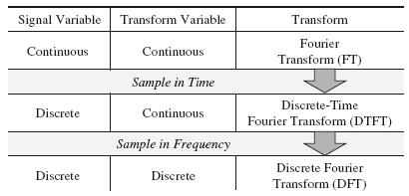


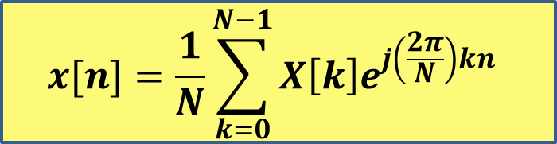
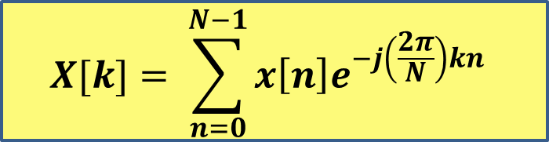
Discrete Fourier Transform(DFT)
$$X[k]= \sum_{n=0}^{N−1}{x\left[n\right]e^{−j\left(\frac{2π}{N}\right)kn}}$$
$$DFT$$
Discrete
$$x[n]=\frac{1}{N}\sum_{k=0}^{N−1}{X\left[k\right]e^{j\left(\frac{2π}{N}\right)kn}}$$
$$Inverse DFT$$
Discrete
DTFT
DFT

Slide 13

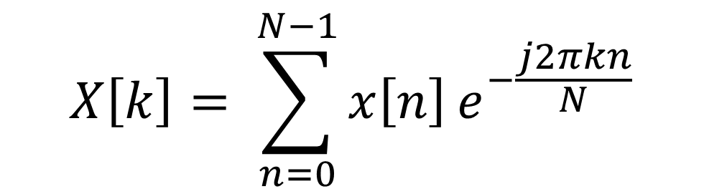

DFT
DFT Programming
$$X\left[k\right]= \sum_{n=0}^{N−1}{x\left[n\right]}e^{−\frac{j2πkn}{N}}$$
$k=0, 1, . . . , N−1$
DFT

Slide 14
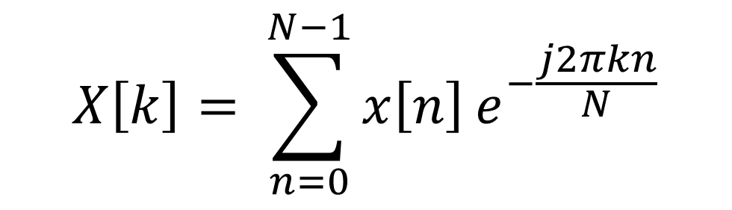

DFT
DFT Programming
$$X\left[k\right]= \sum_{n=0}^{N−1}{x\left[n\right]}e^{−\frac{j2πkn}{N}}$$
$k=0, 1, . . . , N−1$
DFT

Slide 15
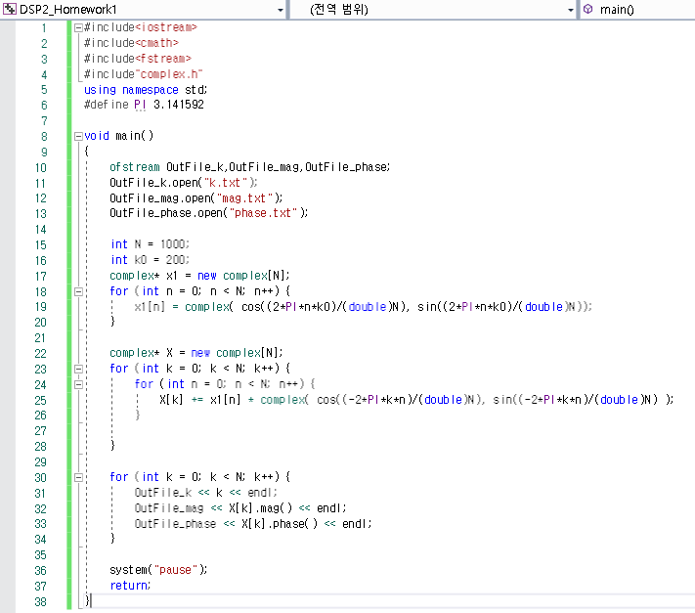

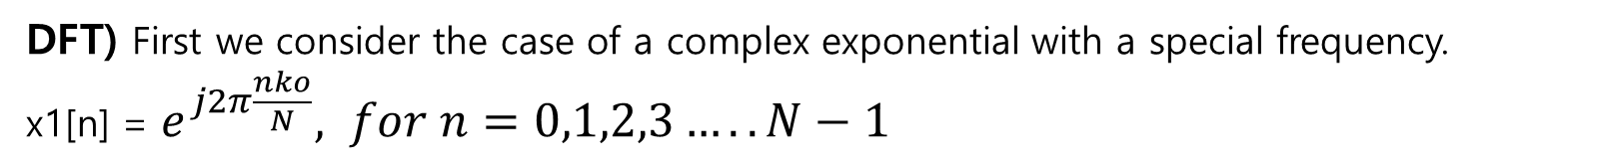
DFT Example1 (Page 336.)
DFT) First we consider the case of a complex exponential with a special frequency.
x1[n] = $e^{j2π\frac{nko}{N}}, for n=0,1,2,3…..N−1$
$ko=$200 , N = 1000
$X\left[k\right]= \sum_{n=0}^{N−1}{x1\left[n\right]}e^{−\frac{j2πkn}{N}}$ 을 구하시오

Slide 16
DFT Example1 (Page 336.)
DFT) First we consider the case of a complex exponential with a special frequency.
x1[n] = $e^{j2π\frac{nko}{N}}, for n=0,1,2,3…..N−1$
$ko=$200 , N = 1000
$X\left[k\right]= \sum_{n=0}^{N−1}{x1\left[n\right]}e^{−\frac{j2πkn}{N}}$ 을 구하시오

Slide 17
DFT Example1 (Page 336.)
DFT) First we consider the case of a complex exponential with a special frequency.
x1[n] = $e^{j2π\frac{nko}{N}}, for n=0,1,2,3…..N−1$
$ko=$200 , N = 1000
$X\left[k\right]= \sum_{n=0}^{N−1}{x1\left[n\right]}e^{−\frac{j2πkn}{N}}$ 을 구하시오

Slide 18
DFT Example1 (Page 336.)
DFT) First we consider the case of a complex exponential with a special frequency.
x1[n] = $e^{j2π\frac{nko}{N}}, for n=0,1,2,3…..N−1$
$ko=$200 , N = 1000
$X\left[k\right]= \sum_{n=0}^{N−1}{x1\left[n\right]}e^{−\frac{j2πkn}{N}}$ 을 구하시오

Slide 19
DFT Example1 (Page 336.)
DFT) First we consider the case of a complex exponential with a special frequency.
x1[n] = $e^{j2π\frac{nko}{N}}, for n=0,1,2,3…..N−1$
$ko=$200 , N = 1000
$X\left[k\right]= \sum_{n=0}^{N−1}{x1\left[n\right]}e^{−\frac{j2πkn}{N}}$ 을 구하시오
엑셀 그래프
출력

Slide 20
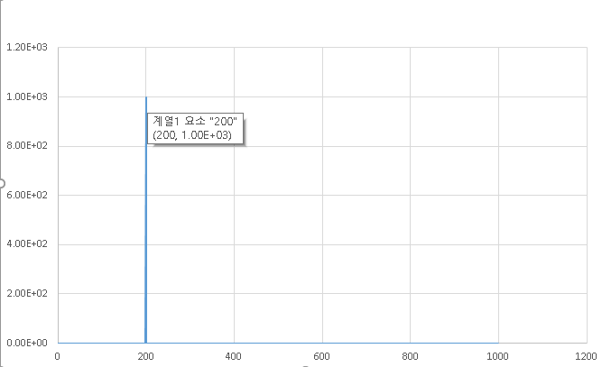
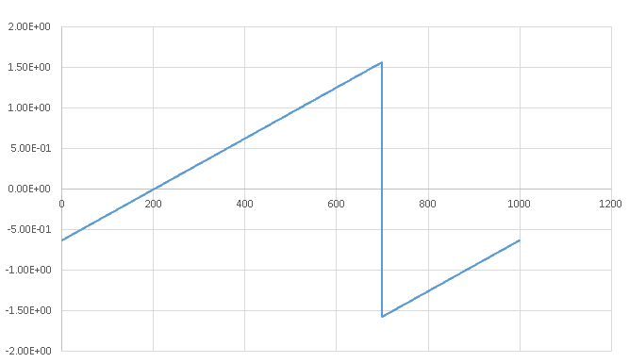

DFT Example1 (Page 336.)
DFT) First we consider the case of a complex exponential with a special frequency.
x1[n] = $e^{j2π\frac{nko}{N}}, for n=0,1,2,3…..N−1$
$ko=200$ , N = 1000
$X\left[k\right]= \sum_{n=0}^{N−1}{x1\left[n\right]}e^{−\frac{j2πkn}{N}}$ 을 구하시오
Magnitude
Phase

Slide 21

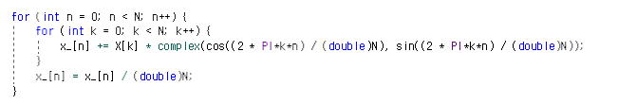
IDFT
IDFT Programming
IDFT

Slide 22
IDFT
IDFT Programming
IDFT

Slide 23
IDFT
IDFT Programming
IDFT

Slide 24
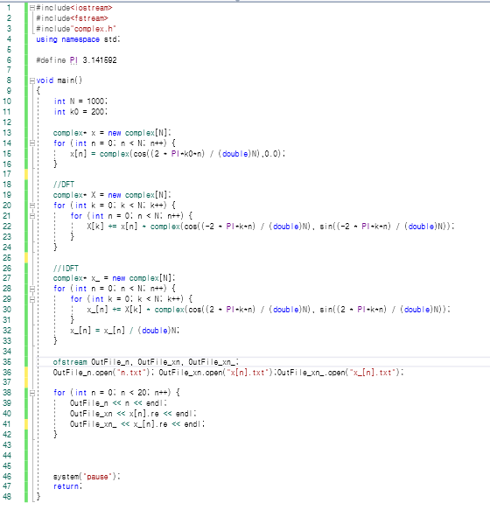
DFT Example1 (Page 336.)
IDFT) x[n] = $\cos\left(0.4πn\right), for n=0,1,2,3…..N−1$
신호 x[n]을 DFT – IDFT한 x_[n]과 x[n] 그래프 비교하기
N = 1000
DFT
IDFT

Slide 25
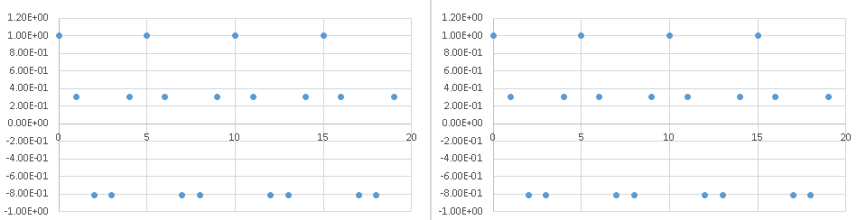
DFT Example1 (Page 336.)
IDFT) x[n] = $\cos\left(0.4πn\right), for n=0,1,2,3…..N−1$
신호 x[n]을 DFT한 후, IDFT하여 x[n] 그래프 비교하기
N = 1000
,x[n]
IDFT 한 x[n]
실제 차이
,n | ,x[n] | ,x_[n]
0 | 1 | 0.999967
1 | 0.309017 | 0.308985
2 | -0.809017 | -0.809043
3 | -0.809017 | -0.809039
4 | 0.309016 | 0.308998
5 | 1 | 0.999985
6 | 0.309018 | 0.309005
7 | -0.809016 | -0.809028
8 | -0.809018 | -0.809029
9 | 0.309015 | 0.309005

Slide 26
사운드 DFT
Week 7 assignment
원본 음악 파일을 DFT 그래프, 노이즈가 낀 음악 파일의 DFT 그래프를 각각 출력하라. 노이즈의 주파수를 구하고 노이즈를 제거한 후 IDFT하여 원본 음악과 비슷한 음악 파일을 생성하라.
[보고서 작성 항목]
음악 파일 DFT 그래프(엑셀)
노이즈가 낀 음악 파일 DFT 그래프(엑셀)
노이즈의 주파수는 몇 Hz인가?
노이즈를 제거한 음악파일(wav 파일)
음악 DFT
D음악 데이터 열기
헤더 정보
DFT
노이즈 제거
IDFT
음악 파일 생성

Slide 27
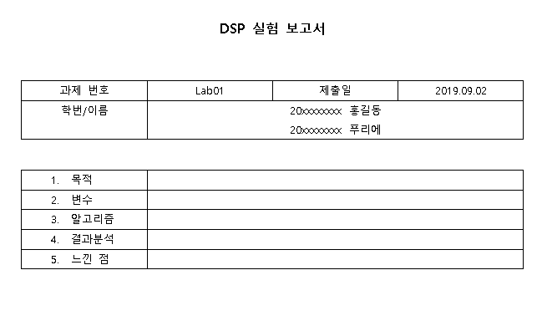

Assignment Rule
“KLAS에 제출할 때 다음 사항을 꼭 지켜주세요”
파일명 : “Lab00_요일_대표자이름.zip”
Ex) Lab01_목_홍길동.zip (압축 툴은 자유롭게 사용)
2. 제출 파일 (보고서와 프로그램을 압축해서 제출)
- 보고서 파일 (hwp, word): 이름, 학번, 목적, 변수, 알고리즘(순서), 결과 분석, 느낀 점
- 프로그램
C++ 프로그램 파일
보고서
압축하여 제출

